Slide 1
This could be the poster title
This could be your sub-line – Abstract #, Authors, Co-Authors, Institution, etc.
*Please remember your Poster should be a 1-page Portrait PDF.
Background/Methods:
Explain why your study matters in the most concise way possible
Use bullet points to create visual space within the text on your poster
Only include what is necessary
Set the stage for the study
Focus more on the Results and Conclusions than on Background and Methods
Results/Graphs/Data:
You can place here:
Graphs
Charts/Comparisons
Images
Tables
* at least 200 dpi. Good picture quality is essential!
Methods:
What did you collect and who did you collect it from?
How did you find this?
How did you test it?
Illustrate your methods if you can.
Why is this study important?
Who does this research help?
Why is it relevant to attendees?
Conclusions/Main Finding
Explain to attendees where the research in the field is going, and why it matters to clinicians.
Emphasize actionable take-home points for optimal attendee learning.
How does this study help move the field forward/ provide value to clinicians and patients?
Include less text in your poster and use more tables/charts/graphs to demonstrate findings.
Important:
Pictures of a sensitive nature should be avoided if it doesn’t add to the content of the poster. (Please note that parents, families and survivors do have access to the poster area)
Further Info:
Please read the detailed guidelines: https://siop-congress.org/poster-presentation-guidelines/
You could insert Acknowledgements, Author Contact Information, Sources, QR Codes here.
This could be your logo.

Slide 2
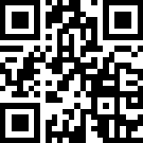
How to use QR Codes
Are QR codes are allowed?
QR Codes may be included in the poster, but cannot link to any promotional or marketing material. If used, they should link to scientific content relevant to the Poster (ie. additional graphs/images/video clip/CV-publications of the authors)
How do I create a QR code?
https://www.qrcode-monkey.com/ is free, URLs don’t expire, and you can add unique features like images.
How do I scan a QR code?
Just take a photo with your phone! All modern cell phones have built-in QR detection in their cameras. Some phones may need an app.

Slide 3
Additional Resources
Make a better poster. Learn more here: https://www.science.org/content/article/how-prepare-scientific-poster
https://www.insidehighered.com/news/2019/06/24/theres-movement-better-scientific-posters-are-they-really-better
Watch these YouTube Videos:
How to create a better research poster in less time (#betterposter Generation 1) – YouTube
How to create a better research poster in less time (#betterposter Generation 2). - YouTube
Most important, please read the detailed poster guidelines for SIOP 2023:
https://siop-congress.org/poster-presentation-guidelines/

Slide 4
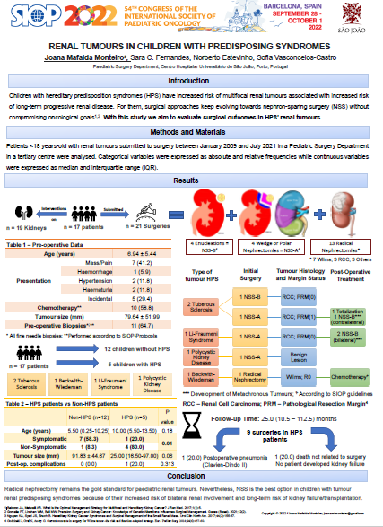
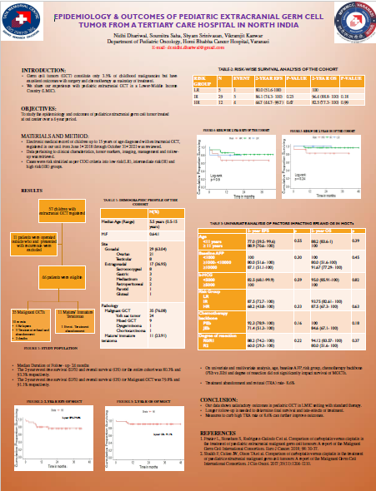
Real Examples from SIOP 2022 Congress

